Slide 1
Curriculum Night
July 26, 2023
8D
Science with Mrs Plona

Slide 2
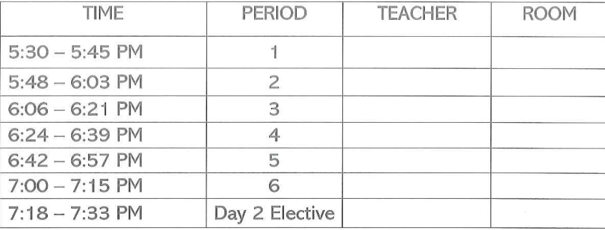
Curriculum Night
Schedule

Slide 3
8th Grade Science
Students will explore science concepts using an inquiry-based approach emphasizing the development and use of models, obtaining and evaluating information, constructing explanations, communicating information, and supporting arguments based on evidence. Topics include the chemical basis of life, structures, and functions of life, the diversity of living things, and the connection of matter, energy, and living things.
Chemical Reactions, Processes, and Equations
Characteristics, Structures & Functions of Cells
Levels of Organization in Organisms
Cell Transport
Photosynthesis & Cellular Respiration Homeostasis
Scientific Method
Safety Properties of Matter
Atoms, Elements, and Periodic Table

Slide 4
Communication
Checking Grades Online
Infinite Campus portal is available via our SJHS webpage and can be added as an app for your phone. Students ID#s and a generic passcode will begin the process.
WEBSITE
Visit Santan’s website online to access general information and Infinite Campus for assignments and test dates for each class.
Google Classroom
You will need to know student log in
Email
plona.kristina@cusd80.com

Slide 5
Make-up Work
Students are responsible for obtaining make up work and instructions before or after school. They should see the teacher to make arrangements.
Typically, students will be given the same number of days to complete that they missed, unless it is a prearranged trip. Worked should be gathered in advance, if it is available, such as field trip absences.
Tutoring is available: Wednesday 8:20-8:50am rm 62

Slide 6
Grading Policy
In our School Community, our focus is on student learning and achievement. At Santan Junior High School,
A student's grade should communicate academic achievement: what the student knows and is able to do as measured against the learning standards of the course.
Extra credit will not be offered upon request.
Assignments must be completed to accurately assess what a student knows and is able to do so that appropriate feedback can be given to every student.
Penalties are issued on late work, 1-5 days late max 80%, 5+ days late max 50%
SJHS Grading Scale:
A: 100% - 90% B: 89% - 80% C: 79% - 70%
D: 69% - 60% F: Below 60%

Slide 7
Classroom Contributions
Thank you for the supplies that you have sent in and please remember that
tax credit donations are always appreciated!
Donations:
Disinfecting wipes, tissues, colored copy paper, red vines (large tub), m & m’s, gummy bears.

Slide 8
Thank you for being a part of curriculum night at Santan!
This presentation is posted on my webpage. Please email me with any additional questions.

